Slide 1
Agile Sprint review

Slide 2
roles

Slide 3

Scrum Master
Servant Leader for the Scrum Team
Responsible for ensuring Scrum is understood and enacted (Cobb, 2015)
Helps facilitate communication with those outside of the Scrum team

Slide 4

Product Owner
Responsible for maximizing the value of the product and the work of the Development Team (Cobb, 2015)
Responsible for managing the Product Backlog
Provides direction on what will be built

Slide 5

Developer
Implements the user stories from the Product Backlog into working software
Developer Teams are self-organizing
Developer Teams are also cross-functional

Slide 6

Tester
Responsible for ensuring that acceptance criteria from user stories are met.
Creates test cases based on user stories
Works closely with Product Owner and Developer to communicate needed changes

Slide 7
The software development lifecycle

Slide 8
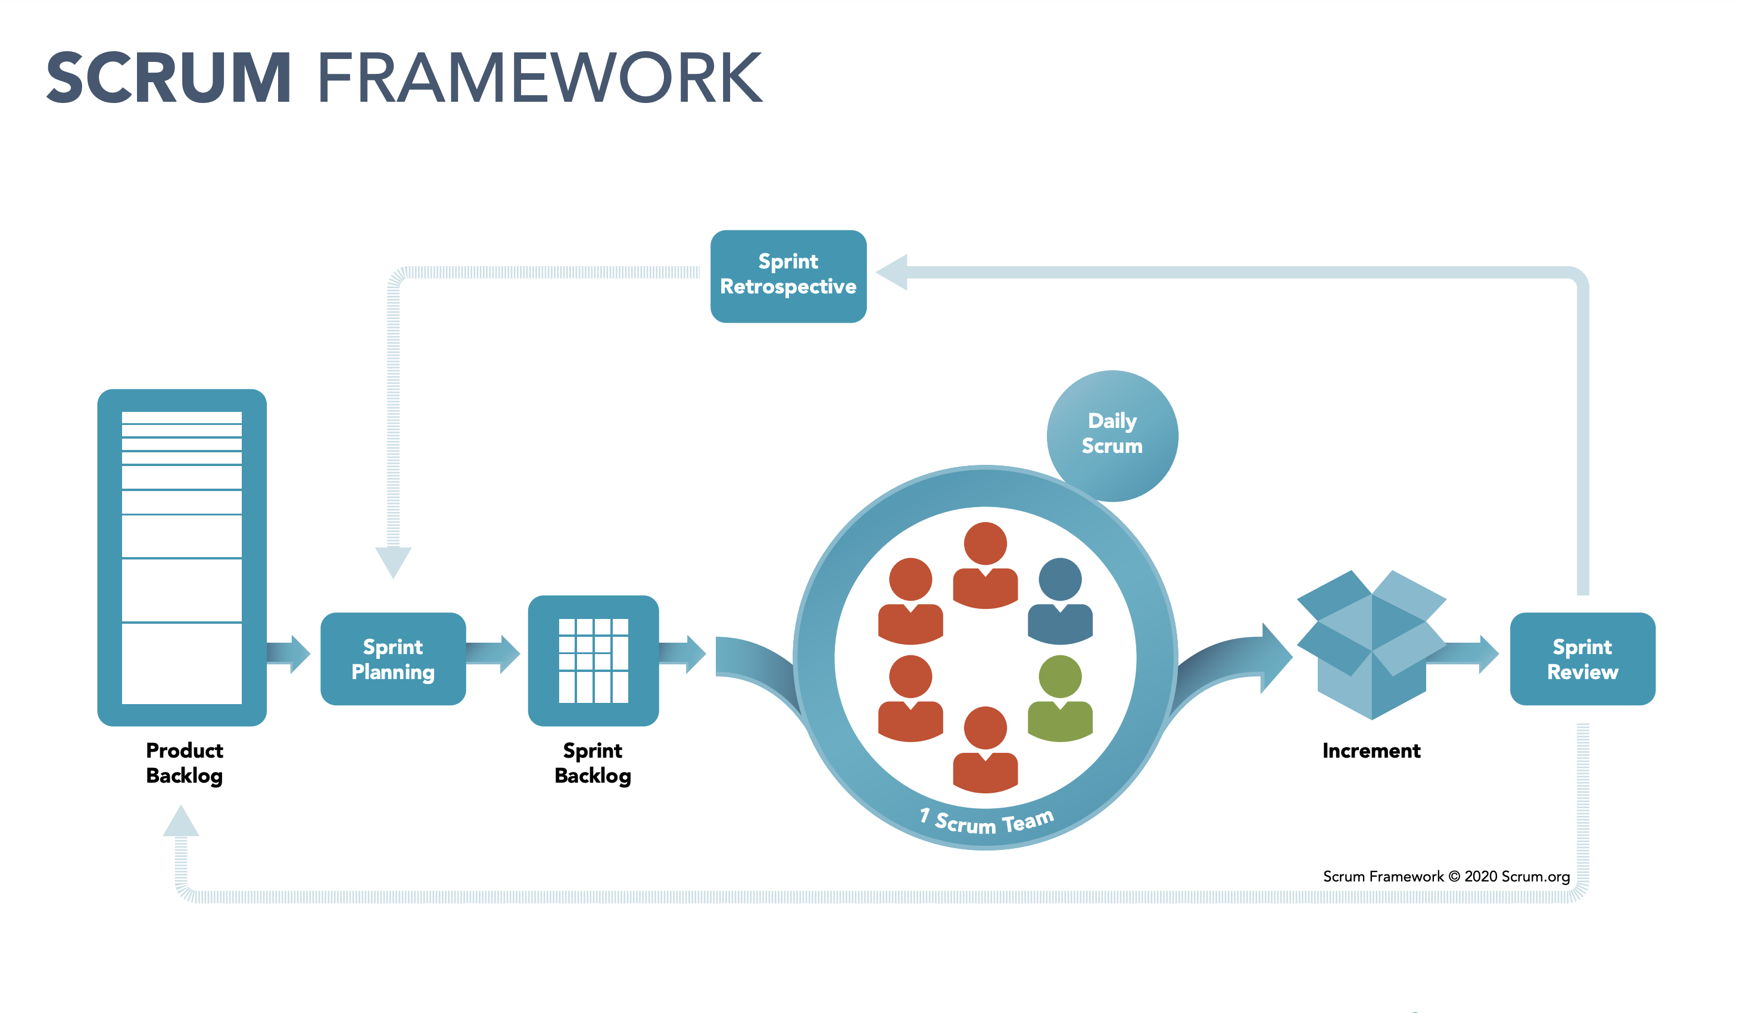

Slide 9

What if we used the waterfall model?
No room for major changes
Couldn't have changed from gallery to carousel views
Couldn't have changed application to focus on wellness vacations

Slide 10
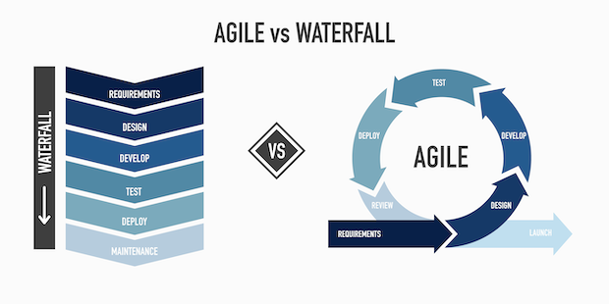
(Your Guide to Agile Software Development Life Cycles, n.d.)

Slide 11
References
Your Guide To Agile Software Development Life Cycles. (n.d.).
Easyagile.com. https://www.easyagile.com/blog/agile-software-development- life-cycle/
Cobb, C. G. (2015). The project manager’s guide to mastering agile : principles and practices for an adaptive approach. John Wiley.
The Scrum Framework Poster. (2019). Scrum.org. https://www.scrum.org/resources/scrum-framework-poster

